Slide 1



Project Capstone Phase B
23-2-D-2
Exploring the Minimum RSSI Fingerprints Needed for Reliable Indoor Localization
Students
Roman Milman
Tomer Meidan
Supervisor
Dr. Julia Sheidin

Slide 2
Table Of Content
The Project’s Objective
Discussion
Conclusion
Background and Related Work
Experiments and Results
Research Process
Proposed Approach

Slide 3
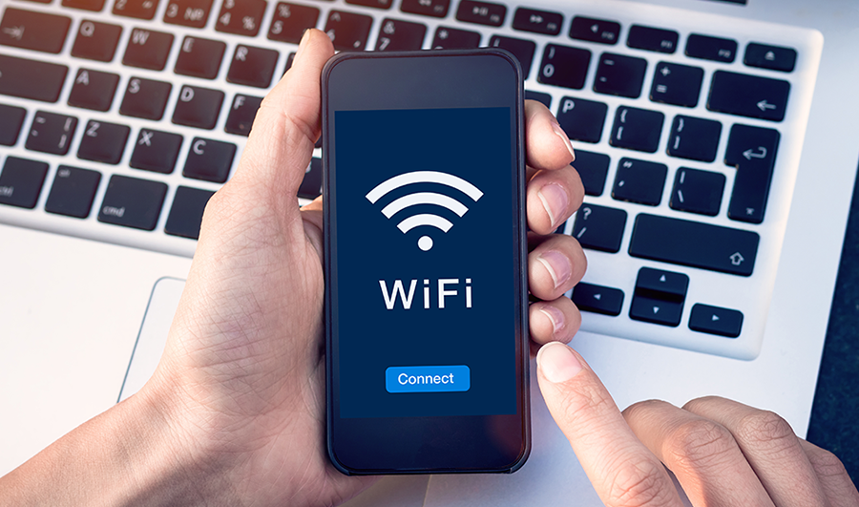
The Project’s Objective
GPS doesn’t work.
Extra hardware is expensive.
Need For Indoor Navigation
The Big Solution
Use existing WiFi APs
Estimate user's location
No extra hardware needed
Broader range indoors
Can penetrate structures
Notes:
More details at the end of the presentation

Slide 4
The Project’s Objective
Explore, Develop and Test the Localization Algorithms
Our study builds upon employing a combination of WKNN and Euclidean distance measures, with a focus on clustering RSSI values into Wifi fingerprints. We learned from the methods and insights presented in these articles that, while the basic k-NN framework provides a reliable starting point, its performance can be substantially improved through thoughtful optimizations and methodological enhancements.
We plan to reduce the number of available fingerprints at specific positions to evaluate the impact on the algorithm's precision. This approach will enable us to understand the trade-offs involved in the fingerprinting process and to optimize the balance between dataset size and localization accuracy.
Notes:
Explore the efficacy of Wi-Fi fingerprinting
Understanding the need for indoor navigation
Comparison to similar systems
Testing the correctness of the algorithm

Slide 5
Background & Related Work
Advances in K-Nearest Neighbors (k-NN) Algorithms
The research by Torres-Sospedra et al. [2] serves as a base in the field of Wi-Fi fingerprinting, providing an analysis of over 50 distance and similarity measures for indoor positioning systems. Their work particularly emphasizes the k-NN algorithm, a distance-based classifier that determines the position by comparing a sample against a database of labeled fingerprints.
Their study advocates for the examination of different data representations, especially considering the influence of distant detected WAPs on localization accuracy, highlighting the significant role of Euclidean distance in such applications due to its intuitive geometric interpretation in the signal space.
Notes:
non parametric, supervised learning classifier

Slide 6
Background & Related Work
Optimization of the k-NN Framework
Zhu’s exploration of an Optimized k-NN (OKNN) algorithm demonstrated a significant improvement in indoor positioning accuracy [4]. By selectively weighting the influence of closer reference points, the OKNN algorithm mitigates the impact of RSS fluctuations and environmental dynamics, improving localization results.
Notes:
Explore the efficacy of Wi-Fi fingerprinting
Understanding the need for indoor navigation
Comparison to similar systems
Testing the correctness of the algorithm

Slide 7
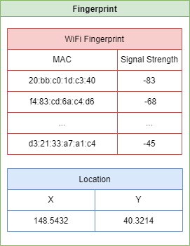

Research Process
Dataset Collection
In our dataset collection and preparation phase, we implemented a structured approach to accurately capture Wi-Fi fingerprints throughout a designated indoor environment, specifically a mall's floor. Using a laptop equipped with specialized software, we systematically recorded Wi-Fi signal strength data. As we navigated through various key points of interest in the mall—such as store entrances, food courts, and main hallways—we ensured that RSSI measurements were captured at one-meter intervals.

Slide 8

Research Process
Algorithm Development
This stage involved implementing preprocessing techniques to clean and standardize the Wi-Fi fingerprint data, ensuring that it was in the optimal form for analysis and application.
Weighted k-NN
The decision to use weighted k-NN was influenced by findings from Torres-Sospedra et al. [2], who highlighted the effectiveness of k-NN in managing the spatial variability inherent in indoor environments. The weighted aspect was introduced to refine the accuracy further by assigning greater importance to nearer points, thus reducing the influence of outliers or distant signals.

Slide 9
Research Process
Algorithm Development
This stage involved implementing preprocessing techniques to clean and standardize the Wi-Fi fingerprint data, ensuring that it was in the optimal form for analysis and application.
Euclidean Distance
We chose to continue utilizing Euclidean distances as our primary metric for distance calculation due to its simplicity and widespread application in existing studies. However, our goal was to explore potential improvements as suggested by the work of Ezhumalai et al. [1], which could be achieved by adjusting the metric to better accommodate the specific signal attenuation characteristics of indoor environments.

Slide 10
Research Process
Algorithm Development
This stage involved implementing preprocessing techniques to clean and standardize the Wi-Fi fingerprint data, ensuring that it was in the optimal form for analysis and application.
Scoring System and RSS OFFSET
We decided to implement a scoring system and RSS OFFSET. These enhancements are intended to manage the variability and inconsistency of RSSI values collected from Wi-Fi access points. The scoring system prioritizes fingerprints based on their signal strength and stability, which aligns with our objective of enhancing reliability in RSSI-based location estimation.

Slide 11
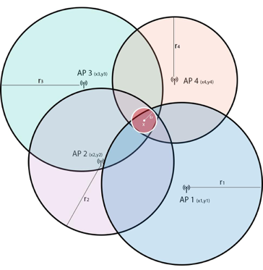
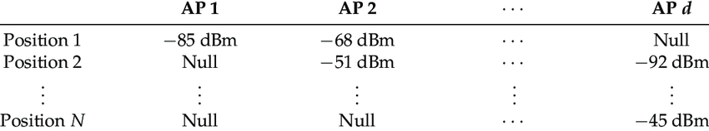
Proposed Approach
1+2
Collecting RSSI and Creating Fingerprint
Walk around the indoor space with a device that measures WiFi signal strengths and record the signal strengths at various locations. Each recorded set of signal strengths is called a fingerprint. These fingerprints are then stored in a database, along with their corresponding locations Article [1]

Slide 12
Proposed Approach
03
Filtering Irrelevant Data
Ignore very low signal strengths from the current fingerprint using threshold T1 [1].
Fingerprint": {
"20:bb:c0:1d:c3:40": -104,
"f4:83:cd:6a:c4:d6": -68,
…
"9c:97:26:4c:55:21": -81,
"00:0e:8e:7a:3d:c3": -100
}
Fingerprint": {
"f4:83:cd:6a:c4:d6": -68,
…
"9c:97:26:4c:55:21": -81,
}
T1 = -100
Notes:
Explore the efficacy of Wi-Fi fingerprinting
Understanding the need for indoor navigation
Comparison to similar systems
Testing the correctness of the algorithm

Slide 13
Proposed Approach
04
Calculating a Subset of Similar Fingerprints
Calculate an Lf, a subset of fingerprints from the map with a relatively big number of common access points (i.e. reachable from the location of f and the fingerprint in Lf) [1] where aps(f) is a set of access points from fingerprint f. In the program, we used MAC addresses to indicate an access point.
Equation 1: Calculation of the subset Lf, consisting of fingerprints with common access points and a sufficient number of overlaps with the current fingerprint.
Notes:
Explore the efficacy of Wi-Fi fingerprinting
Understanding the need for indoor navigation
Comparison to similar systems
Testing the correctness of the algorithm

Slide 14
Proposed Approach
Calculating a Subset of Similar Fingerprints
Inputs: Two fingerprints - one from the current dataset (fingerprint) and one from the reference set (refFp).
Process:
Retrieves sets of APs from both fingerprints that exceed a defined minimum signal strength.
This threshold ensures that only significant APs are considered, reducing noise in the data.
calculates the intersection of APs present in both fingerprints and identifies APs unique to each.
The score is computed using the formula: 2 * size of intersection - size of unique APs in fingerprint - size of unique APs in refFp.
Output:
An integer score that serves as a quantitative measure of similarity between the two fingerprints.
Notes:
Explore the efficacy of Wi-Fi fingerprinting
Understanding the need for indoor navigation
Comparison to similar systems
Testing the correctness of the algorithm

Slide 15
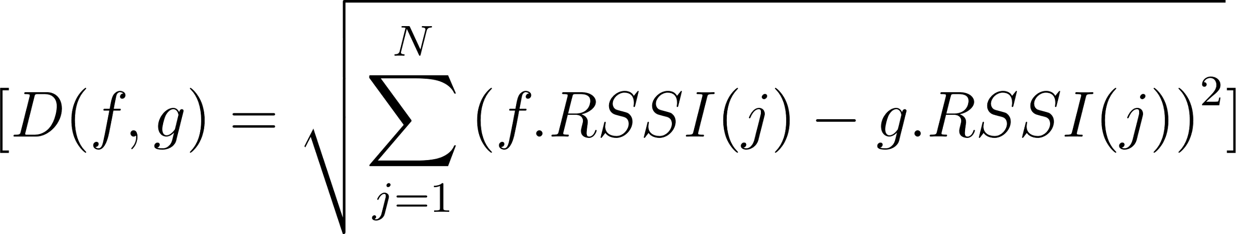
Proposed Approach
05
Calculating Dissimilarity
Calculate the dissimilarity between the current fingerprint and each fingerprint in Lf using the Euclidean distance in N-dimensional space, where N is the number of access points that are reachable from both the current fingerprint and a fingerprint from Lf. The j-th coordinate is the signal strength of the j-th access point in the fingerprint [1]:
Equation 2: Calculation of dissimilarity between the current fingerprint and a fingerprint from Lf, based on the difference in received signal strength (RSS) values of common access points.
Notes:
Explore the efficacy of Wi-Fi fingerprinting
Understanding the need for indoor navigation
Comparison to similar systems
Testing the correctness of the algorithm

Slide 16
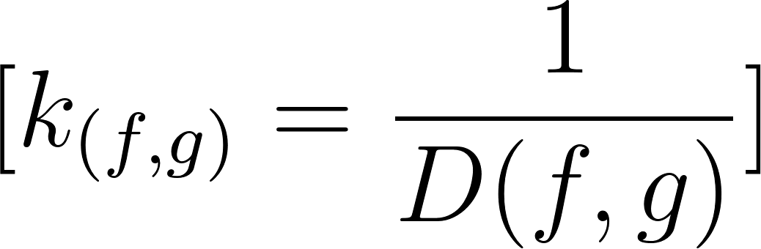
Proposed Approach
06
Calculating Similarity
Calculate the similarity between the current fingerprint and each fingerprint in Lf using the [Article 1], This similarity is used as a weighting factor in averaging locations of fingerprints in Lf.
Equation 3: Calculation of similarity between the current fingerprint and a fingerprint from Lf, as the inverse of the dissimilarity value.
Notes:
Explore the efficacy of Wi-Fi fingerprinting
Understanding the need for indoor navigation
Comparison to similar systems
Testing the correctness of the algorithm

Slide 17
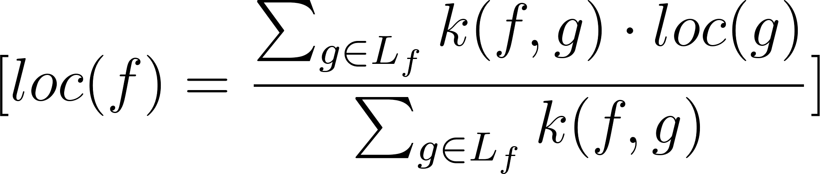
Proposed Approach
07
Estimating the Location
Estimate the location of the mobile device by calculating a weighted average of the locations of the similar fingerprints, where the weights are based on the similarity between the current fingerprint and each of the similar fingerprints [3]:
Equation 4: Estimation of the location of the current fingerprint by computing the weighted average of the known locations of fingerprints in Lf, using the similarity values as weights.
Notes:
Explore the efficacy of Wi-Fi fingerprinting
Understanding the need for indoor navigation
Comparison to similar systems
Testing the correctness of the algorithm

Slide 18
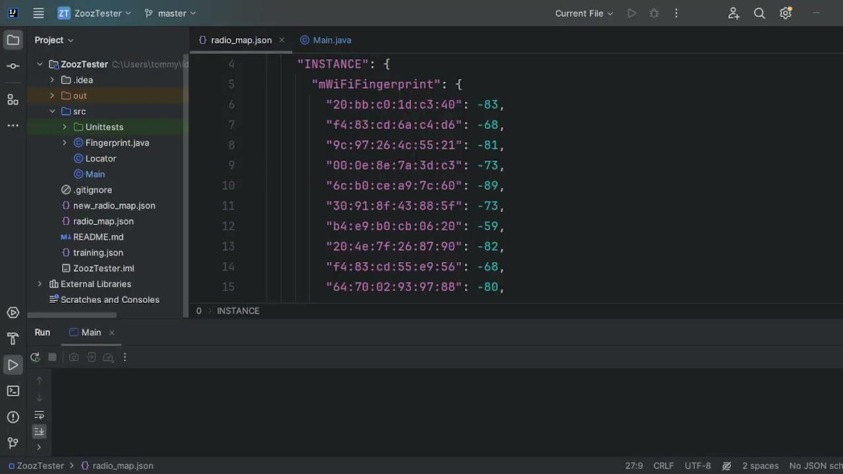
Notes:
Explore the efficacy of Wi-Fi fingerprinting
Understanding the need for indoor navigation
Comparison to similar systems
Testing the correctness of the algorithm

Slide 19

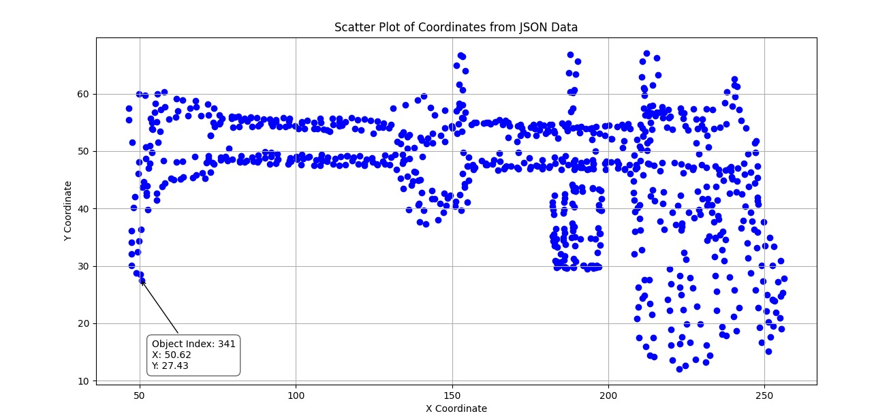
Experiments and Results
The experiment was designed to capture a set of Wi-Fi signal strength readings, or 'fingerprints', across the entire expanse of a mall floor
The "Scatter Plot of Coordinates from JSON Data" offers a visual representation of the collected fingerprints.
The blue dots scattered across the plot demonstrate an extensive collection effort, covering a wide array of spatial scenarios within the mall.
Figure 5: Fingerprints data collected fingerprints at numerous locations throughout the mall.

Slide 20
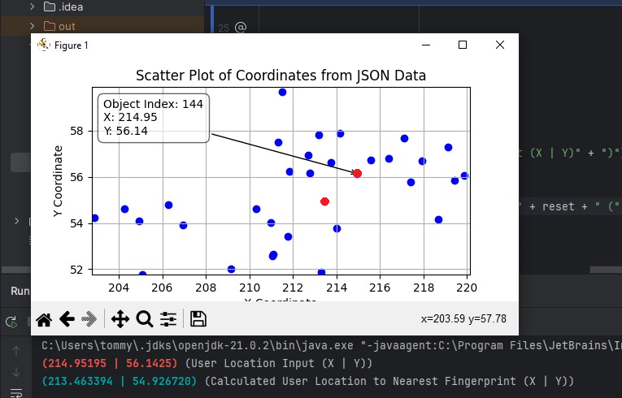
Experiments and Results
Accuracy Assessment of Nearest Fingerprint
Following the widespread data collection of Wi-Fi fingerprints throughout a mall, we proceeded to evaluate the precision of our indoor positioning system. This section delves into the validation of our system's ability to accurately pinpoint the nearest fingerprint to a given user location input.
Data
Collection of 786 fingerprints
Remove one to simulate a real-time location
The system was tasked to identify the nearest fingerprint
Figure 8: Output result of a location estimation based on training data with arrow point at expected location.

Slide 21
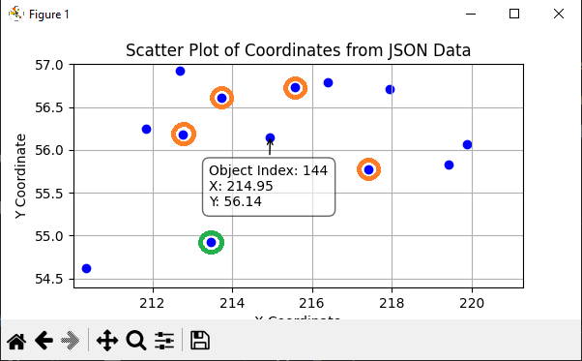

Experiments and Results
Accuracy Assessment of Nearest Fingerprint
Through the analysis of the provided data, it has been determined that Object Index 143 (green dot), has RSSI values that are more closely aligned with the central fingerprint than those of the other nearby fingerprints (orange dots), despite being further away in terms of physical distance. This underscores the significance of RSSI values in establishing proximity in a Wi-Fi fingerprinting context.
 | Near the Removed Fingerprint |  |  |  | Actual | Removed Index
MAC/FP-DB Index | 694 | 420 | 695 | 704 | 143 | 144
b4:e9:b0:cb:06:20 | -84 | -82 | -74 | -84 | -74 | -74
70:62:b8:32:a0:15 | -87 | -88 | -87 | -85 | -86 | -86
20:bb:c0:1d:db:90 | -44 | -48 | -59 | -62 | -52 | -52
00:0e:8e:7a:99:26 | -73 | -75 | -63 | -69 | -63 | -71
00:18:e7:fd:01:e2 | -67 | -66 | -75 | -74 | -68 | -72
70:62:b8:32:a0:14 | -74 | -82 | -83 | -78 | -75 | -75
fc:75:16:b0:ae:75 | -78 | -78 | -74 | -74 | -73 | -78
c0:ff:d4:bd:97:16 | -64 | -76 | -69 | -68 | -72 | -72
Similar RSSI values | 1 | 1 | 1 | 0 | 5
The conclusion drawn from the test is that the accuracy of Wi-Fi fingerprinting for location-based services relies more on the correlation of signal strengths than on geographical closeness.

Slide 22
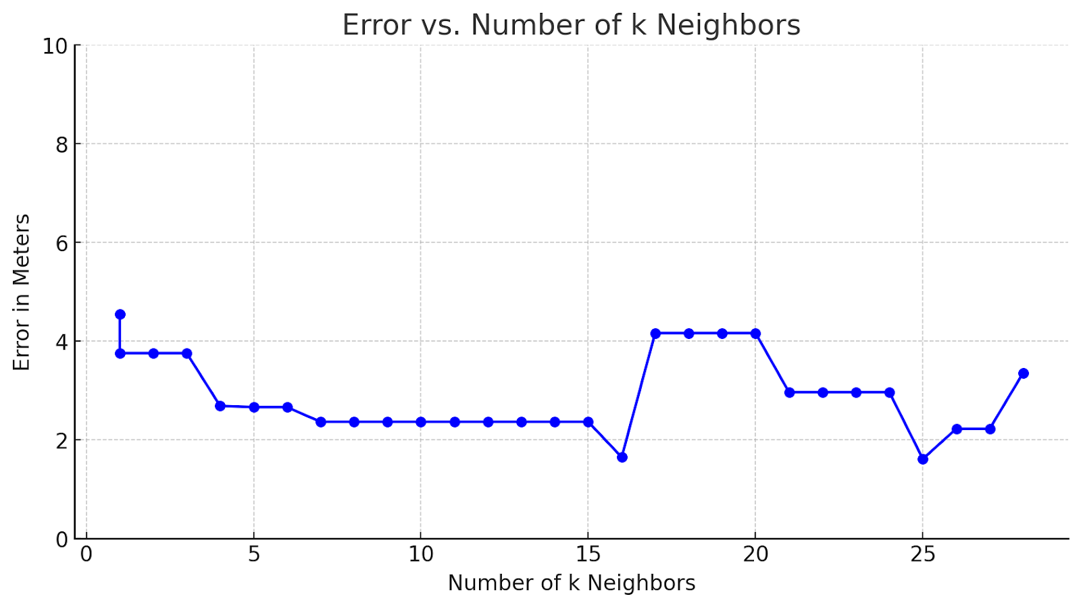
Experiments and Results
Decreasing Fingerprint Cluster Experiment
The current experiment conducted on a single mall floor integrates algorithmic enhancements designed to refine accuracy and reliability.
The results demonstrate a substantial improvement in positioning precision:
The minimum error observed was 1.613164 meters at 25 neighbors.
For a broader range of 'k' values from 7 to 15, the error consistently hovered around 2.365007 meters.
Notably, even when increasing 'k' values up to 28, the error rates remained relatively low, with a slight rise to 3.358885 meters, indicating stability in the model's performance under less complex architectural constraints.

Slide 23
Discussion
In examining various studies on Wi-Fi RSS fingerprint-based indoor positioning using the Euclidean distance with k-Nearest Neighbors (k-NN) and Weighted k-Nearest Neighbors (WKNN), we compare their results with our own. By focusing on the number of nearest neighbors and the achieved error rates, we can discern the effectiveness of each approach.
Study | Algorithm | K Value | Mean Error (meters)
Our Project | WKNN + Score | 25 | 1.62
Moreira et al. [5] | WKNN | 3 | 6.20 - 6.79
Torres-Sospedra et al. [2] | k-NN Variants | 3 | ~7.4
Liu et al. [7] (Dataset 2) | WKNN + k-means | 4 | ~8.4
Table 5: This table compares the error rates achieved by various indoor positioning methods utilizing Euclidean distance alongside k-NN or WKNN algorithms.

Slide 24
Conclusion
In this analysis, we have explored various methodologies for indoor positioning using Wi-Fi fingerprinting, comparing the approaches and outcomes from studies with our own project's results. While our approach did not achieve the lowest error rates with the minimum number of k-nearest neighbors (k-NN) compared to some Bayesian filtering techniques, it significantly enhanced the traditional Euclidean distance model using weighted k-NN and additional scoring mechanisms.
Our project stands out by incorporating RSS OFFSET for handling missing access points and a scoring mechanism for fingerprint comparison. These enhancements are tailored to address the dynamic signal environments typically found in commercial settings like malls. By integrating these improvements, we have demonstrated that it is possible to achieve competitive results that are highly applicable and robust for real-world applications.

Slide 25
Thank you for listening!

Slide 26
References
[1] Ezhumalai, B., Song, M., & Park, K. (2021). An efficient indoor positioning method based on Wi-Fi RSS fingerprint and classification algorithm. Sensors, 21(10), 3418.
[2] Torres-Sospedra, J., Montoliu, R., Trilles, S., Belmonte, Ó., & Huerta, J. (2015). Comprehensive analysis of distance and similarity measures for Wi-Fi fingerprinting indoor positioning systems. Expert Systems with Applications, 42(23), 9263-9278.
[3] Teuber, Andreas & Eissfeller, Bernd. (2006). WLAN indoor positioning based on Euclidean distances and fuzzy logic.
[4] Zhu, Xuanyu. (2020). Indoor Localization Based on Optimized KNN. Network and Communication Technologies. 5. 34. 10.5539/nct.v5n2p34.
[5] Moreira, Adriano & Nicolau, Maria & Meneses, Filipe & Costa, António. (2015). Wi-Fi fingerprinting in the real world - RTLS@UM at the EvAAL competition. 1-10. 10.1109/IPIN.2015.7346967.
[6] Arigye W, Pu Q, Zhou M, Khalid W, Tahir MJ. RSSI Fingerprint Height Based Empirical Model Prediction for Smart Indoor Localization. Sensors (Basel). 2022 Nov.
[7] S. LIU, R. DE LACERDA and J. FIORINA, "WKNN indoor Wi-Fi localization method using k-means clustering based radio mapping," 2021 IEEE 93rd Vehicular Technology Conference.
[8] Babalola OP, Balyan V. WiFi Fingerprinting Indoor Localization Based on Dynamic Mode Decomposition Feature Selection with Hidden Markov Model. Sensors.
[9] Chen, Pan & Shang, Jianga & Gu, Fuqiang. (2020). Learning RSSI Feature via Ranking Model for Wi-Fi Fingerprinting Localization.
[10] Dai, Jihan, Maoyi Wang, Bochun Wu, Jiajie Shen, and Xin Wang. 2023. "A Survey of Latest Wi-Fi Assisted Indoor Positioning on Different Principles" Sensors 23, no. 18: 7961.

Slide 27
References
The Project’s Objective
For Slide #3
01
Understanding the Need For Indoor Navigation
The lack of indoor navigation could be particularly challenging and can be a significant inconvenience. It can lead to wasted time and effort as individuals try to find their way around large buildings and can make it difficult to navigate complex indoor spaces efficiently in large buildings, such as airports, shopping malls, or office buildings. For example, individuals who are in a hurry to catch a flight at an airport may waste valuable time trying to find their gate. Similarly, in large shopping centers, individuals may struggle to find the stores they are looking for, leading to wasted time and increased stress.

Slide 28
References
For Slide #3
02
Comparison to Similar Systems
GPS Doesn’t Work Indoors
While traditional outdoor navigation systems-based technology exists, they are not suitable for indoor environments. Today's most popular navigation system is the GPS (Global Positioning System), however, GPS itself does not use context awareness. GPS is a satellite-based navigation system that provides users with accurate location and time information in outdoor environments.
Additional Unique Hardware
Known systems for indoor navigation require additional unique hardware to function properly [4]. Companies in this field rely on a mobile application that uses their developed sensors and special hardware that is proprietary to their company. The sensors must include a large number of RF wireless sensors and special receivers called Readers, which detect signals from the sensors.

Slide 29
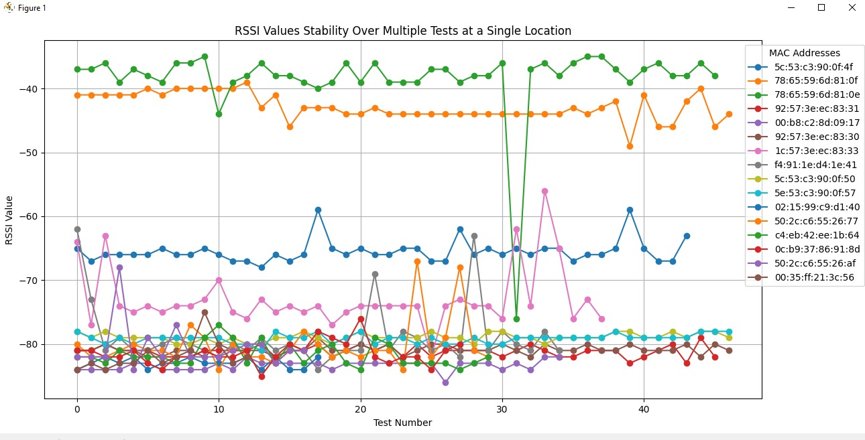
References
Stability Evaluation of RSSI Readings
The study entailed collecting multiple RSSI measurements from various MAC addresses at a single, fixed location. The objective was to replicate a static user environment, closely monitoring the RSSI value consistency from the surrounding access points.
Figure 6: Fingerprint RSSI measurements from various MAC addresses at a single, fixed location.

Slide 30
References
Stability Evaluation of RSSI Readings - Table Results
mac | Test # | mean | std | min | 25% | 50% | 75% | max
5c:53:c3:90:0f:4f | 44 | -65.4773 | 1.784802 | -68 | -66 | -66 | -65 | -59
78:65:59:6d:81:0f | 47 | -42.8298 | 2.088469 | -49 | -44 | -43 | -41 | -39
78:65:59:6d:81:0e | 46 | -38.3913 | 5.900954 | -76 | -39 | -38 | -36 | -35
92:57:3e:ec:83:31 | 46 | -81.1304 | 0.832898 | -83 | -82 | -81 | -81 | -79
00:b8:c2:8d:09:17 | 35 | -83.3429 | 0.764771 | -86 | -84 | -83 | -83 | -82
92:57:3e:ec:83:30 | 47 | -80.8511 | 0.690895 | -82 | -81 | -81 | -80 | -79
1c:57:3e:ec:83:33 | 38 | -72.9474 | 4.798352 | -82 | -75 | -74 | -73.25 | -56
f4:91:1e:d4:1e:41 | 35 | -78.8857 | 4.843257 | -84 | -81 | -81 | -79 | -62
5c:53:c3:90:0f:50 | 47 | -78.9149 | 0.653745 | -80 | -79 | -79 | -78.5 | -78
a2:b5:3c:b1:95:26 | 6 | -81.5 | 3.72827 | -84 | -83 | -83 | -82.25 | -74
5e:53:c3:90:0f:57 | 47 | -79.1064 | 0.698882 | -81 | -79.5 | -79 | -79 | -78
02:15:99:c9:d1:40 | 18 | -82.9444 | 0.802366 | -84 | -83.75 | -83 | -82 | -82
50:2c:c6:55:26:77 | 30 | -80.1667 | 3.769966 | -84 | -82 | -81 | -80 | -67
a8:63:7d:10:9e:42 | 5 | -81.4 | 1.81659 | -84 | -82 | -81 | -81 | -79
fa:8f:ca:92:de:00 | 7 | -82.1429 | 1.676163 | -85 | -83 | -81 | -81 | -81
c4:eb:42:ee:1b:64 | 30 | -81.7 | 1.784029 | -84 | -83 | -82 | -80.25 | -77
0c:b9:37:86:91:8d | 28 | -81.3929 | 1.812289 | -85 | -82 | -82 | -81 | -76
50:2c:c6:55:26:af | 17 | -80.4706 | 3.590224 | -84 | -82 | -82 | -80 | -68
00:35:ff:21:3c:56 | 13 | -81.8462 | 2.375084 | -84 | -83 | -83 | -81 | -75
68:aa:c4:b2:63:40 | 5 | -81.2 | 1.643168 | -83 | -82 | -82 | -80 | -79
The table provides a view of how the RSSI values for each MAC address vary across multiple tests. This is for analyzing the stability and reliability of the Wi-Fi signal from various devices in a specific location.
Results:
The average RSSI values ranged significantly across devices
The standard deviation (std) provides a measure of how consistent the signal strength was for each device
The minimum and maximum values highlight the range of RSSI values recorded.

